Slide 1
IST687 – Applied Data Science
Storage Wars

Slide 2
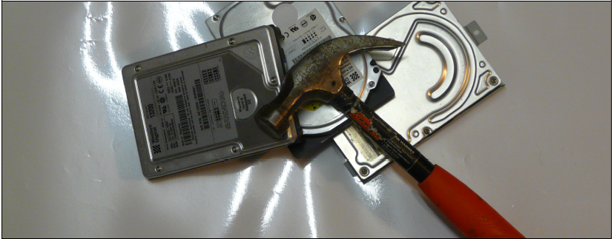
Data Science
Before now we have only used a small amount of data that we typed ourselves, or somewhat larger amounts that we extracted from Twitter. The world is full of other sources of data, however, and we need to examine how to get them into R, or at least to make them accessible for manipulation in R. In this chapter, we examine various ways that data are stored, and how to access them

Slide 3
Data Science
Objectives
Recognizing different data types, data sets, and data bases as sources for "R" analysis
Building and executing relevant "R" code to import different data types, data sets, and accessing remote and/or local databases
Excel
JSON
Database

Slide 4
Data Science
Connecting R to external data sources
2 threads
Data in a discrete “flat” file format
Data in non discrete format i.e. “system” oriented such as a traditional relational database
R Data Import/Export
range of methods for obtaining data from a wide variety of programs and formats
http://cran.r-project.org/doc/manuals/R-data.html

Slide 5
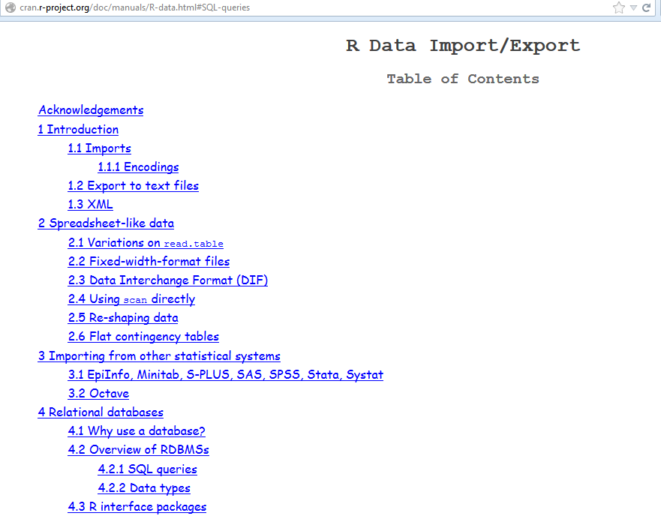
Data Science

Slide 6
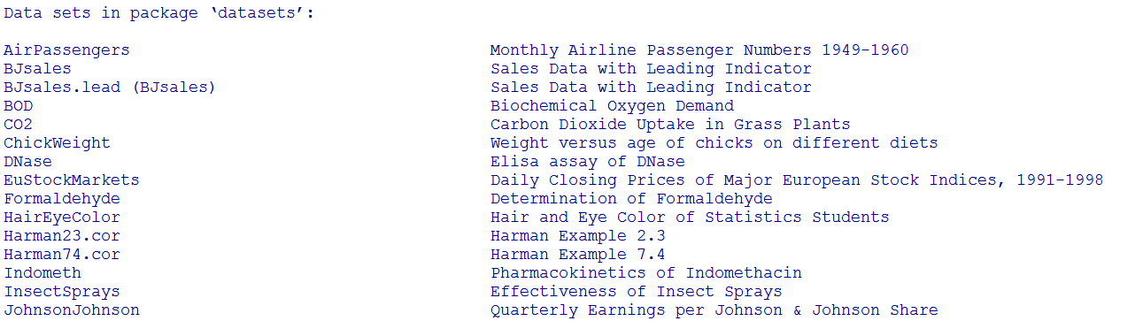
Data Science
R Supplied Datasets – Discrete files
> data()

Slide 7
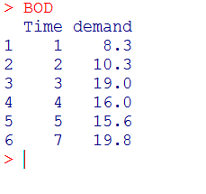
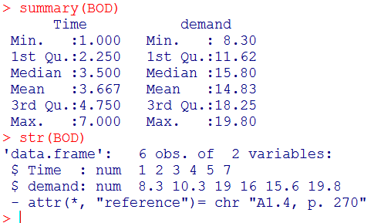
Data Science
R Supplied Datasets – Discrete files
> BOD # Biochemical Oxygen Demand

Slide 8
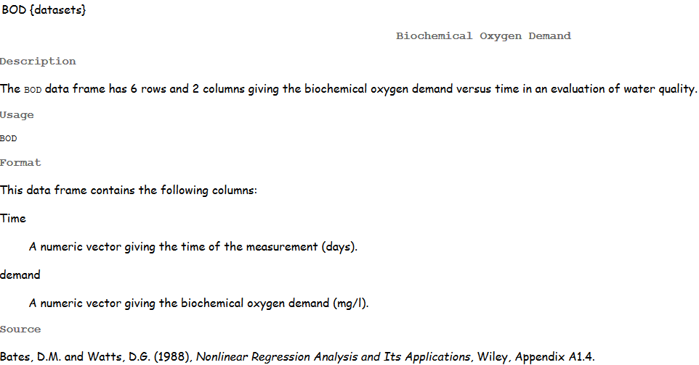
Data Science
R Supplied Datasets – Discrete files
> help(BOD)

Slide 9
Data Science
Connecting R to external data sources – Discrete files
Utilize R-Studio: Import Dataset option
Tab delimited
Comma delimited
Decimal
Examples
Using R-Studio import function on comma & tab delimited data sets

Slide 10
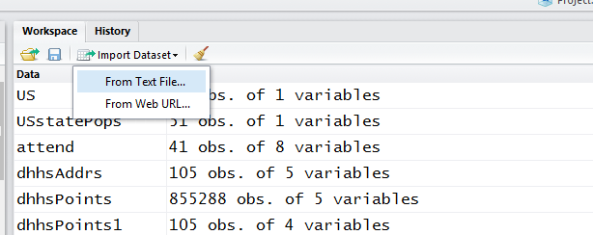
Data Science
Import via RStudio
Upper right quadrant of RStudio

Slide 11

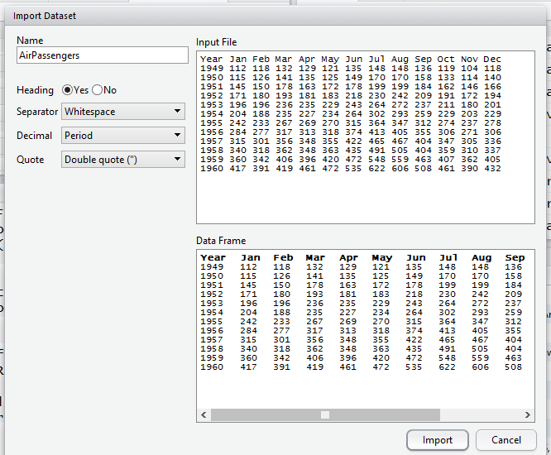
Data Science
text file

Slide 12
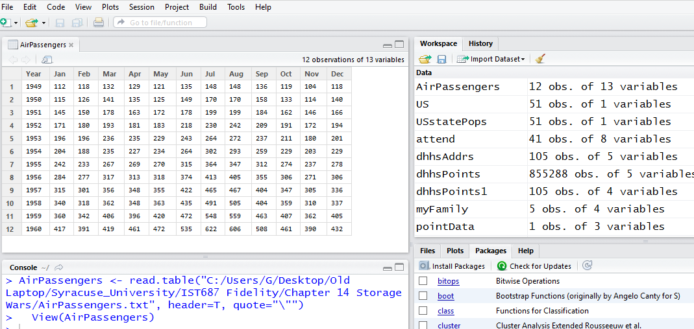
Data Science

Slide 13
Data Science
Connecting R to external data sources – Discrete files
R Packages
RODBC (Windows)
xlsReadWrite (Windows)
xlsx (Mac)
XLConnect (Mac)
gdata
read.xls function
http://cran.r-project.org/web/packages/gdata/gdata.pdf
> ls("package:gdata") #list content of gdata package

Slide 14
Data Science
Connecting R to external data sources – Discrete files
Read/load census data we viewed in Chapter 6 via read.xls (included in the R gdata package)
Look at data set at census.gov before executing read.xls
Prepare gdata package for use: R command line or R-Studio
> install.packages(“gdata”)
> library(“gdata”)
> testFrame<-read.xls( "http://www.census.gov/popest/data/state/totals/2011/tables/NST-EST2011-01.xls")

Slide 15
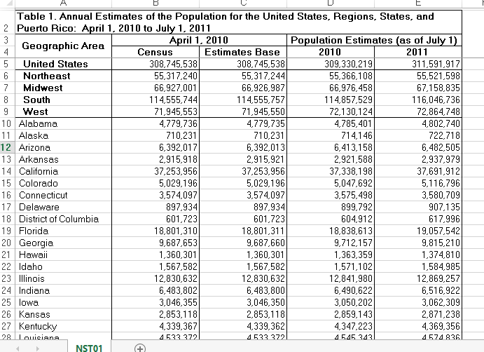
Data Science
http://www.census.gov/popest/data/state/totals/2011/tables/NST-EST2011-01.xls

Slide 16
Data Science
Connecting R to external data sources – Discrete files
View the results of read.xls View(testFrame)
Visually compare source data from the census.gov to what has been read into R, specifically the dataframe testFrame
Use the structure function str(testFrame) to provide summary statistics about the dataframe testFrame
Key ‘take aways’ about testFrame
Variable names relative to selected column headings are not clear
Variable columns of no use ie… x.4 through x.8
Data is in character string format vs. numeric
Overall, the dataset/data frame needs to be “cleansed” & “transformed” before starting any subsequent R analysis

Slide 17
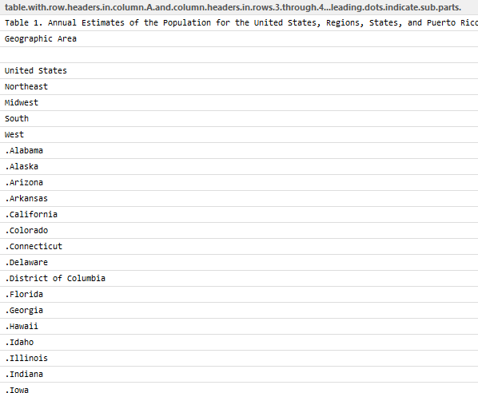
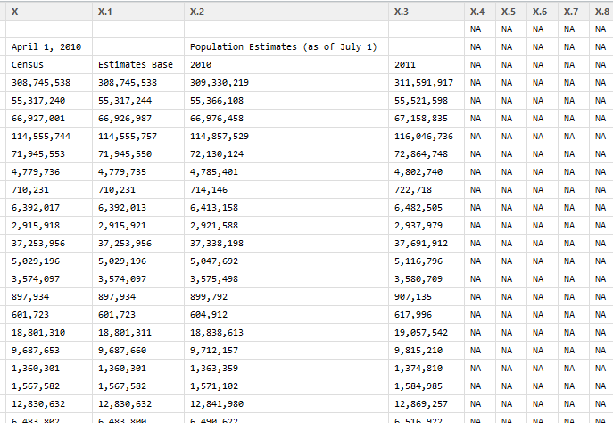
Data Science
> View(testFrame) # View the results of read.xls

Slide 18
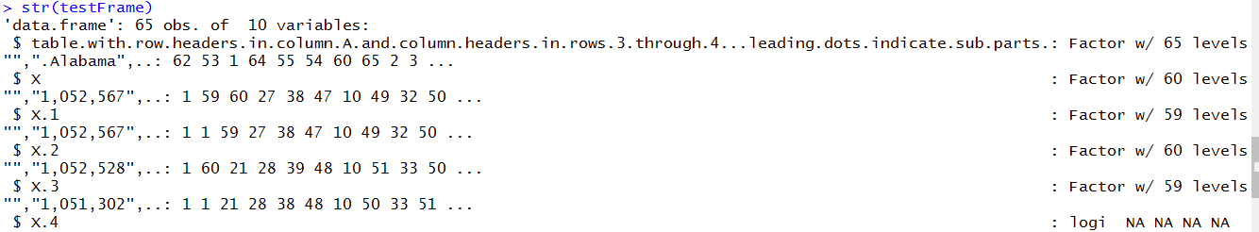
Data Science
> str(testFrame) # structure of testFrame

Slide 19
Data Science
Connecting R to external data sources – Discrete files
“testFrame” Cleansing & Transformation Process
Cleansing
Remove header rows
Remove un-needed columns
Remove last few rows
Copy 1st column to a column with a reasonable name
Remove 1st column
Transformation
Remove dots on front of state names
Convert “factor” / character data to numeric via a custom developed function … Numberize
Cleansing & Transformation Summary
“fit for the purpose”
Recommend viewing “testFrame” at various cleansing and transformation steps to see the affect of the “R” statement
Load the “stringr” package

Slide 20
Data Science
“testFrame” Cleansing & Transformation Process
Cleansing
testFrame<-testFrame[-1:-3,] # remove 1st 3 rows,,, column parameter empty
testFrame<-testFrame[,1:5] # keep 1st 5 columns,,, row parameter empty
tail(testFrame,5) # Look at the last 5 rows of testFrame
testFrame<-testFrame[-58:-62,] # remove last 5 rows
testFrame # view testFrame post Cleansing

Slide 21
Data Science
“testFrame” Cleansing & Transformation Process
Transformation
testFrame$region <- testFrame[,1] # give 1st Column a name .. region
testFrame<-testFrame[,-1] #
#
testFrame$region <- str_replace(testFrame$region,"\\.","") # remove dots in front of state name
#
# Numberize() - Gets rid of commas and other junk and converts to numbers
# Assumes that the inputVector is a list of data that can be treated as character strings
#
Numberize <- function(inputVector)
{
inputVector<-str_replace_all(inputVector,",","") # remove commas
inputVector<-str_replace_all(inputVector," ","") # remove spaces
return(as.numeric(inputVector))
}
#
# Apply Numberize function to columns in testFrame and give columns a new name
#
testFrame$april10census <-Numberize(testFrame$X)
testFrame$april10base <-Numberize(testFrame$X.1)
testFrame$july10pop <-Numberize(testFrame$X.2)
testFrame$july11pop <-Numberize(testFrame$X.3)
testFrame # look at testFame post transformation

Slide 22
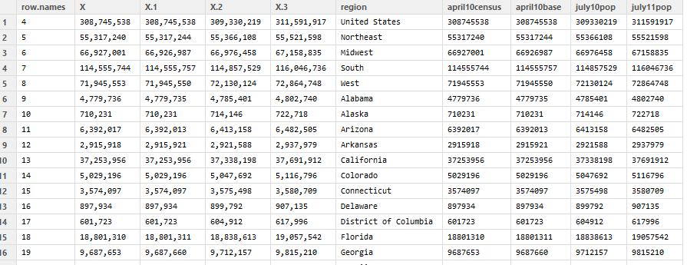
Data Science
> View(testFrame)

Slide 23
Data Science
Non discrete data access
remote system/application databases i.e. relational DB, “servers”
Rationale
Source/target data is too large to store in local memory
Source/target data is too large to store on local disk
Not efficient to make copies of large “system” databases
Preference that analysis is always on current “official” source content vs a copy
R is not designed to be a database manager

Slide 24
Data Science
Evaluate/test Google geocode api
http://maps.googleapis.com/maps/api/geocode/json?address=1600+Pennsylvania+Avenue,+Washington,+DC&sensor=false
Sample output on next slide

Slide 25
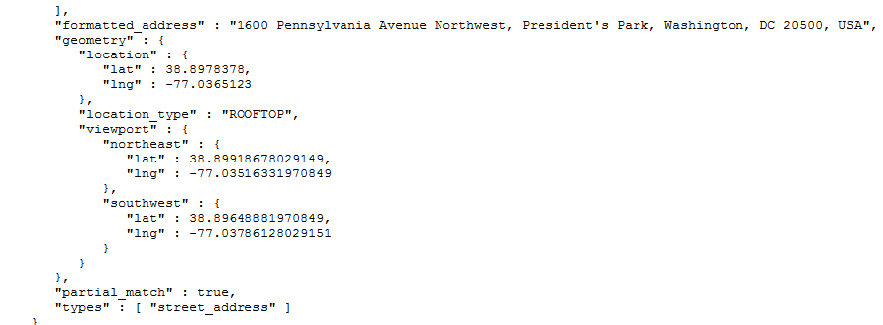
Data Science
Java Script Object Notation

Slide 26
Data Science
Create a function to accept an ‘address’ argument, insert it into the Google geocode URL
MakeGeoURL <- function(address)
{
root <- "http://maps.google.com/maps/api/geocode/"
url <- paste(root, "json?address=",address, "&sensor=false", sep = "")
return(URLencode(url))
}

Slide 27
Data Science
MakeGeoURL( "1600 Pennsylvania Avenue,Washington, DC")
"http://maps.google.com/maps/api/geocode/json?add
ress=1600%20Pennsylvania%20Avenue,%20Washington,%
20DC&sensor=false"
function
argument
Function results

Slide 28
Data Science
Create a function to
take result of MakeGeoURL,
send it to the internet via getURL and receive results
isolate results (latitude, longitude coordinates) via fromJSON

Slide 29
Data Science
Addr2latlng <- function(address)
{
url <- MakeGeoURL(address) # set up URL string
apiResult <- getURL(url) # send URL string to internet
# and store result
geoStruct <- fromJSON(apiResult, simplify = FALSE) # apply JSON notation
lat <- NA
lng <- NA
try(lat <- geoStruct$results[[1]]$geometry$location$lat) # isolate latitude
try(lng <- geoStruct$results[[1]]$geometry$location$lng) # isolate longitude
return(c(lat, lng))
}

Slide 30
Data Science
Using Addr2latlng
>testData <- Addr2latlng( "1600 Pennsylvania Avenue, Washington, DC")
> str(testData)
num [1:2] 38.9 -77 # latitude and longitude coordinates

Slide 31
Data Science
Accessing More JSON data
> bikeURL <-"https://www.citibikenyc.com/stations/json"
> apiResult <-getURL(bikeURL)
> Results <- fromJSON(apiResult)
> length(results)
[1] 2

Slide 32
Data Science
More on Parsing JSON data
> when <- results[[1]]
> when [1]
"2016‐01‐03 11:56:40 AM"
The next results is actually a list of stations
> stations <-results[[2]]
> length(stations)
[1] 508

Slide 33
Data Science
Structure of the data record
> str(station[[1]])
List of 18
$id: num 72
$stationName: chr ”W52 St & 11 Ave"
$availableDocks: num 5
$totalDocks: num 39
$latitude: num 40.8
$longitude: num ‐74
$statusValue: chr "In Service"
$statusKey: num 1
$availableBikes: num 34
$stAddress1: chr ”W 52 St & 11 Ave"
$stAddress2: chr "”
$city: chr ""
$postalCode: chr ""
$location: chr ""
$altitude: chr ""
$testStation: logi FALSE
$lastCommunicationTime: chr "2016‐01‐03 11:53:24 AM"
$landMark: chr ""

Slide 34
Data Science
Create a data frame (from a list)
> numRows <- length(stations)
> nameList <- names(stations[[1]])
> dfStations <-data.frame(matrix(unlist(stations), nrow=numRows, byrow=T), stringsAsFactors=FALSE)
#Finally, we need to name the columns appropriately:
> names(dfStations) <-nameList

Slide 35
Data Science
Clean up and use the data frame
> df$availableDocks <- as.numeric(df$availableDocks)
> df$availableBikes <- as.numeric(df$availableBikes)
> df$totalDocks <- as.numeric(df$totalDocks)
> mean(df$availableDocks)
[1] 21.41142

Slide 36
Data Science
Non discrete data access – Database connectivity packages
RMySQL
ROracle
RPostgresSQL
RSQlite
RMongo
RODBC
Chapter examples
RODBC
MySQL
SQLServer 2012
Microsoft Access

Slide 37
Data Science
Environment Pre Requisites (non “R” activity)
MySQL
Download/install MySQL
Download/install Northwind database in your MySQL instance
Configure ODBC for your MySQL instance
SQL Server 2012
Download/install SQL Server 2012
Download/install Northwind database in your SQL Server instance
Configure ODBC for your SQL Server instance
Microsoft Access
Download/install MS Access Northwind DB from IST687 course Blackboard Resources->Course Library->Data Sets, Databases
2 versions of Northwind Access DB: .mdb .accdb
You can choose either

Slide 38
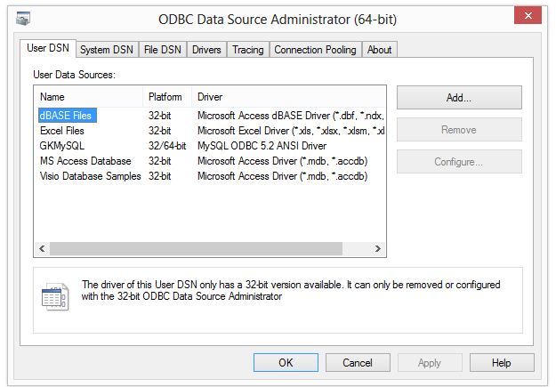
Data Science
Environment Pre Requisites (non “R” activity) mySQL
ODBC name will be used in “R” ODBC connect statement

Slide 39
Data Science
MySQL “R” code
# establish R connection to GKMySQL
>conmysql <- odbcConnect("GKMySQL")
# assign SQL table list
>tblsmysql<-sqlTables(conmysql)
# View Northwind tables
>tblsmysql
# assign SQL Query script to datamysql
>datamysql<-sqlQuery(conmysql,paste("select * from Products"))
# view output of SQL select,, note: view command shows formatted results in script window in RStudio
>datamysql
>View(datamysql)
Note: RODBC Package must be loaded
MySQL ODBC name

Slide 40
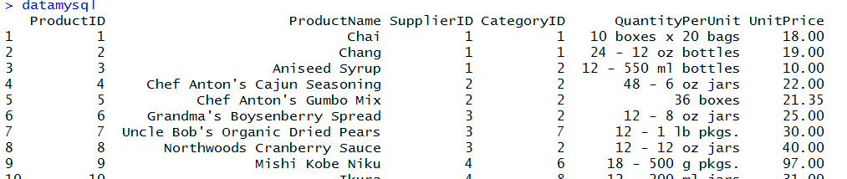
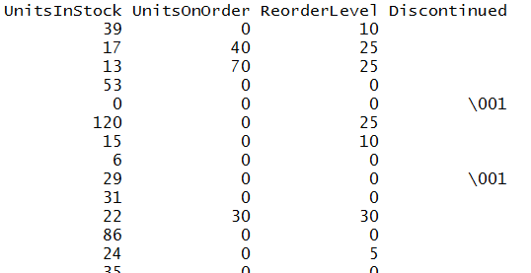
Data Science
View(datamysql)

Slide 41
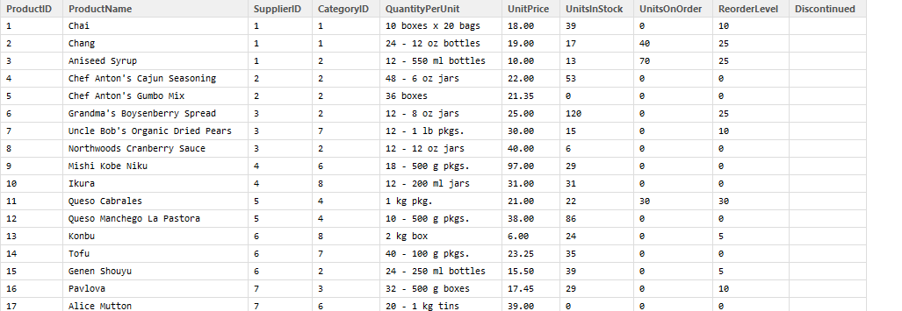
Data Science
View(datamysql)
>View(datamysql)

Slide 42
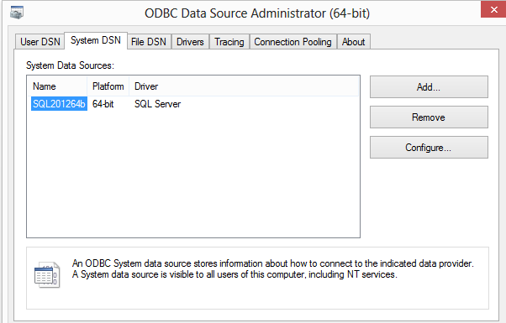
Data Science
Environment Pre Requisites (non “R” activity) SQLServer
ODBC name will be used in “R” ODBC connect statement

Slide 43
Data Science
Note: RODBC Package must be loaded
SQLServer “R” code
# establish R connection to SQL201264b
>conSQL2012 <- odbcConnect(“SQL201264b")
# assign SQL table list
>tblsSQL2012<-sqlTables(conSQL2012)
# View Northwind tables
>tblsSQL2012
# assign SQL Query script to dataSQL2012
>dataSQL2012<-sqlQuery(conSQL2012,paste("select * from Products"))
# view output of SQL select
>dataSQL2012
>View(dataSQL2012)
SQLServer ODBC name

Slide 44
Data Science
Sqldf Package
install.packages("sqldf")
library("sqldf")
sqldf('select mtcars.mpg from mtcars')
sqldf('select count(mtcars.mpg) from mtcars where cyl=4’)

Slide 45
Data Science
sapply Function in R
# sapply(Variable, Function, optional parameters)
sapply(mtcars, mean)
mpg cyl disp hp drat wt qsec vs am
20.090625 6.187500 230.721875 146.687500 3.596563 3.217250 17.848750 0.437500 0.406250 gear carb
3.687500 2.812500

Slide 46
Data Science
tapply Function in R
# tapply(Summary Variable, Group Variable, Function)
tapply(mtcars$mpg, mtcars$cyl, mean)
4 6 8
26.66364 19.74286 15.10000
tapply(mtcars$mpg, mtcars$cyl, meanPlusSD)
meanPlusSD <- function(v){
t <- mean(v) + sd(v)
return(t)
}

Slide 47
IST687 – Applied Data Science
End of Lecture Storage Wars

